Slide 1

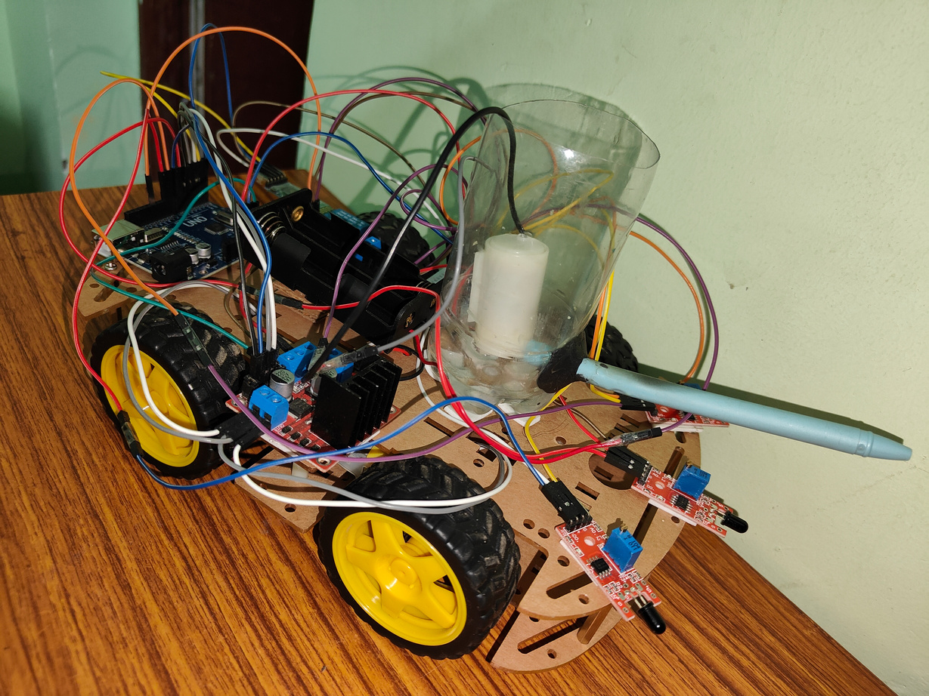

ME-396
AUTOMATIC FIRE TRUCK

Slide 2
ABOUT US
MENTOR : DR.SOMNATH SARANGI
TEAM MEMBERS :
G. Meghasyam
S. Kartheek
D. Yuvakiran
A.P. Giriteja
A. Navneeth
2101ME24
2101ME68
2101ME21
2101ME03
2101ME04

Slide 3
Content
1
2
3
4
5
6
7
INTRODUCTION
CHALLENGES ENCOUNTERED
WHAT DID WE FIGURE OUT
ABOUT APP
DEMONSTRATION VIDEOS
CODE FOR PROJECT
RESULT AND DISCUSSION

Slide 4

INTRODUCTION
An automatic fire truck is designed to detect and respond to fires without human involvement, providing a rapid and efficient emergency response.
Whenever it detects the fire, it will move towards the direction of fire and spills water on it.
With the help of MIT app developer, we have introduced a new idea a voice controller app.

Slide 5
CHALLENGES ENCOUNTERED
Long-distance fire detection is impossible with the firefighting truck we are utilizing.
We are dealing with a water leak issue in the tank.
When trying to acquire the desired output (spilling water) from the pump we were using, we encountered less power input.

Slide 6
What did we figure out
For the water leak problems, we reconstructed the tank using the M-seal to close the leakage holes.
We considered using speech recognition app as a means of system control for long-distance fires.
We have enhanced the code by adding voice control functionality.
For voice control to pass the commands we have added a Bluetooth Module to our Truck.
To overcome the power issue for the pump we used the relay module component which amplify the power input .

Slide 7
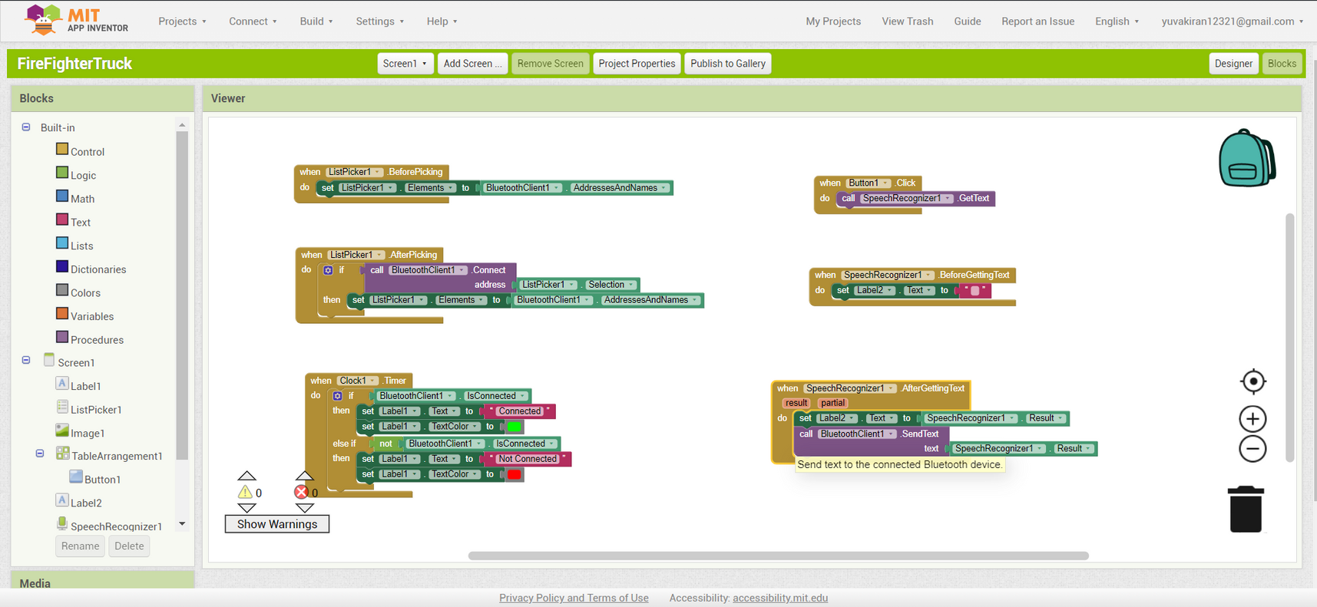
Buildings Blocks of our App

Slide 8
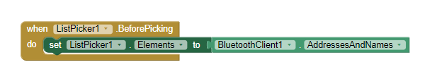
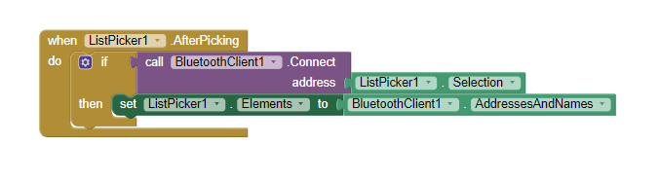
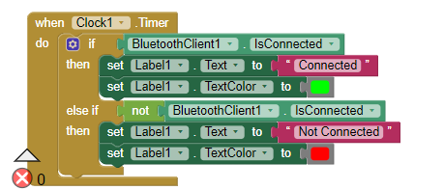
List picker displays every component needed to indicate a Bluetooth device that is in range.
Following the selection of a certain device This specific gadget, this specific block, will create a Bluetooth connection
The connected text will be shown if the connection is successful. If it's not connected it will appear not connected text

Slide 9
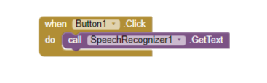
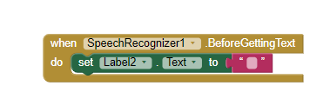
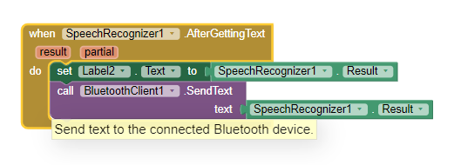
The do button is in charge of recording the speech.
Following your speech, this block will be transformed into a string and saved in a variable named text.
This text would be transmitted to Arduino over Bluetooth.

Slide 10
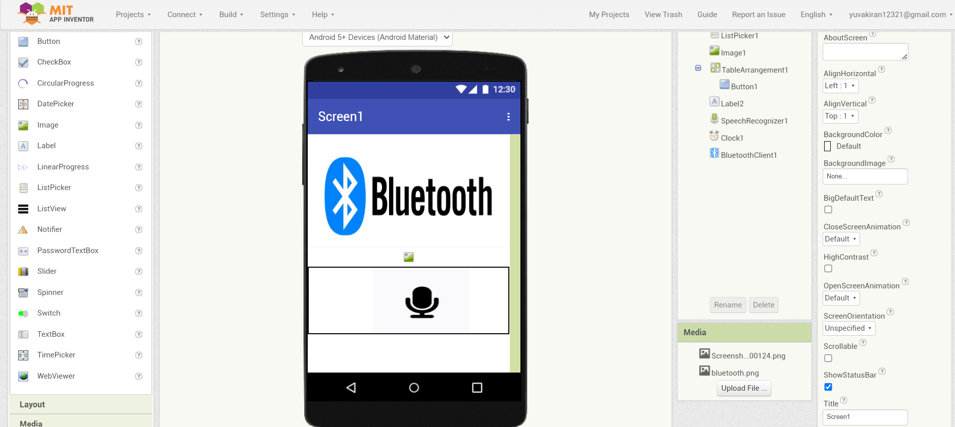
This is the Interface of Voice Control app we Created.

Slide 11

Code For the Project

Slide 12
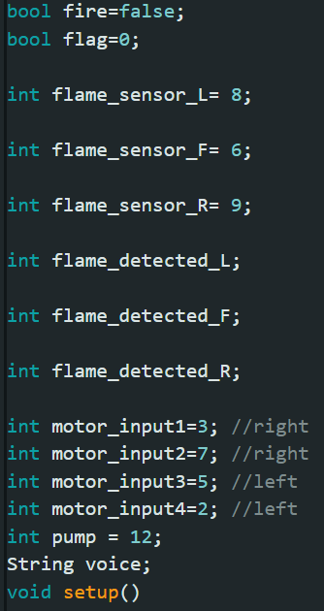
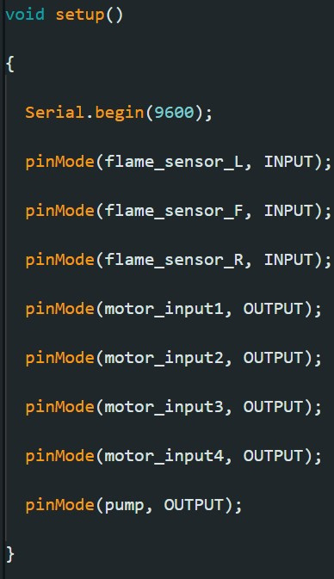

Slide 13
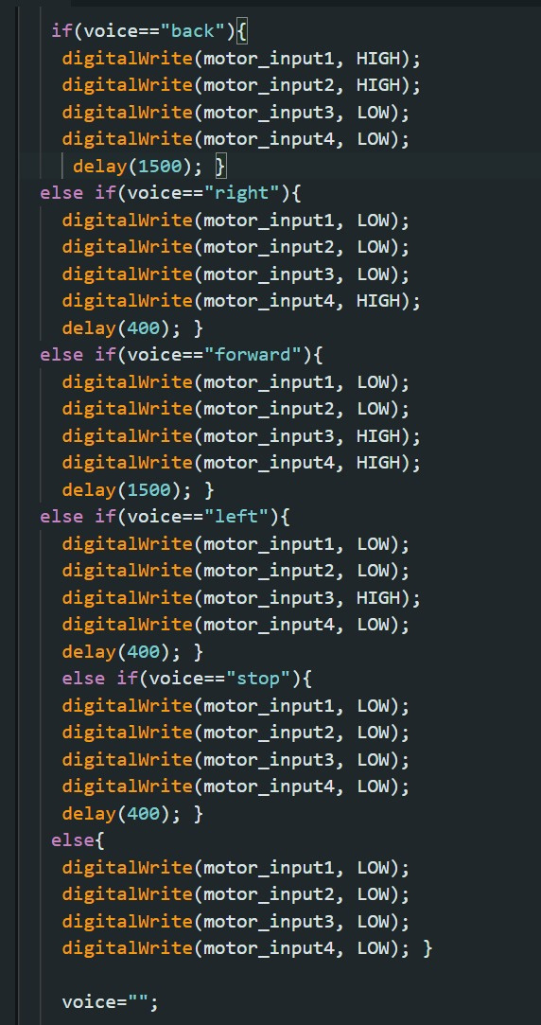
Voice Control Code

Slide 14
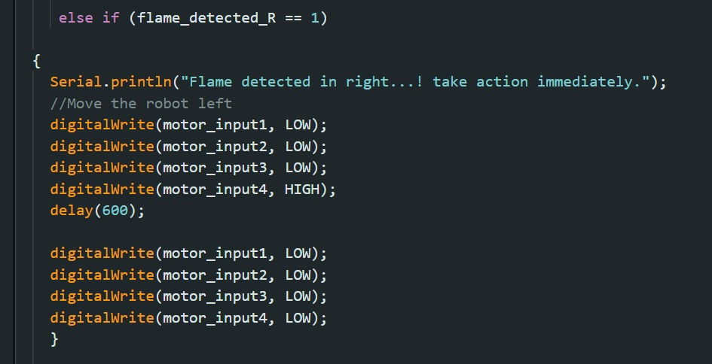
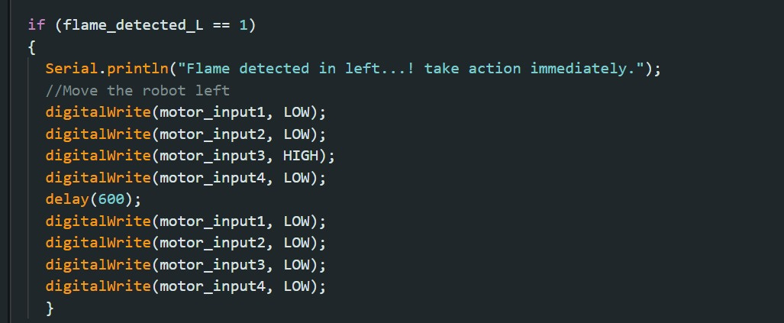
Code to move Truck Rightward
Code to move Truck Leftward

Slide 15
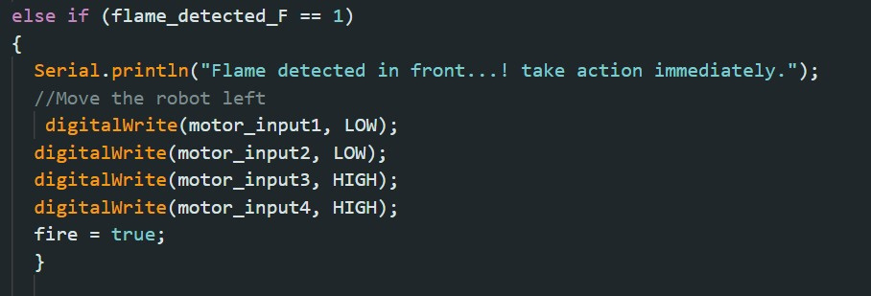
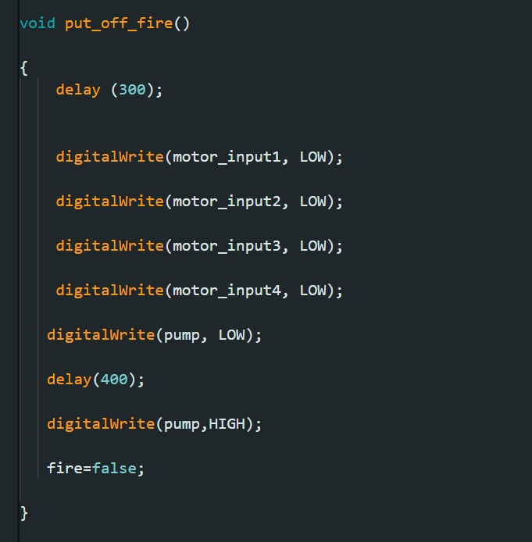
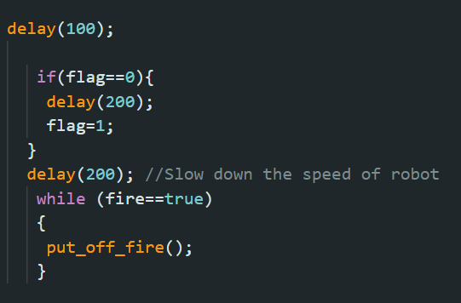
Code to Move Truck Forward
Code to Putoff Fire

Slide 16

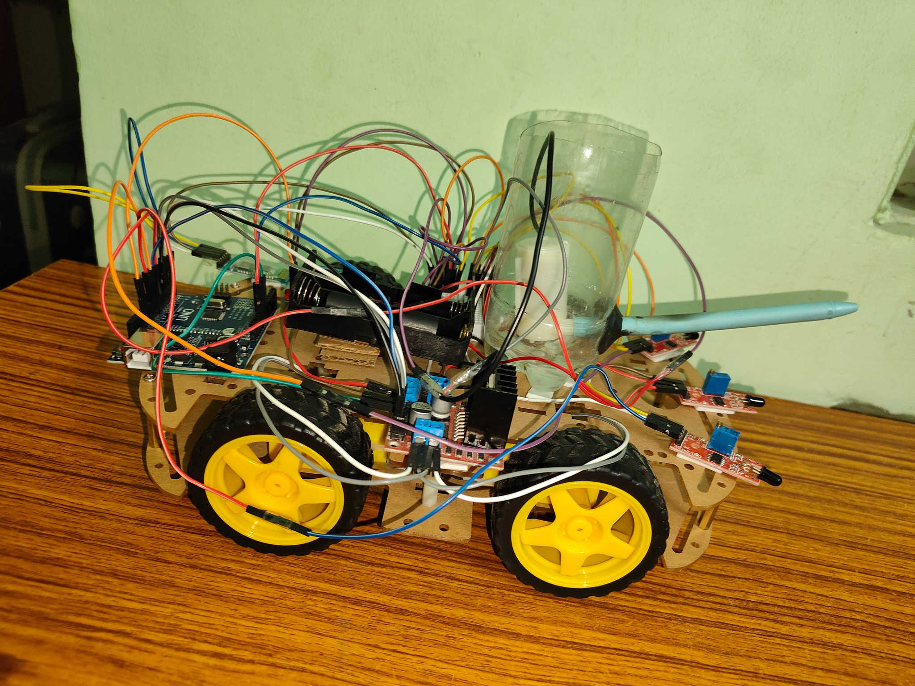

DEMONSTRATION
VIDEOS
DEMONSTRATION
VIDEOS

Slide 17
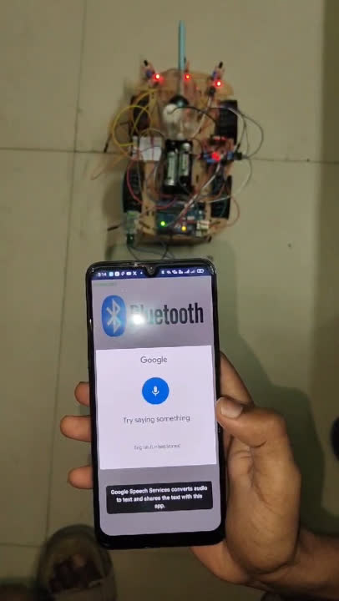
VOICE CONTROL DEMONSTRATION
RIGHT INSTRUCTION
Whenever the speech recognizer detects the right speech, then the car moves as shown.
RIGHT

Slide 18
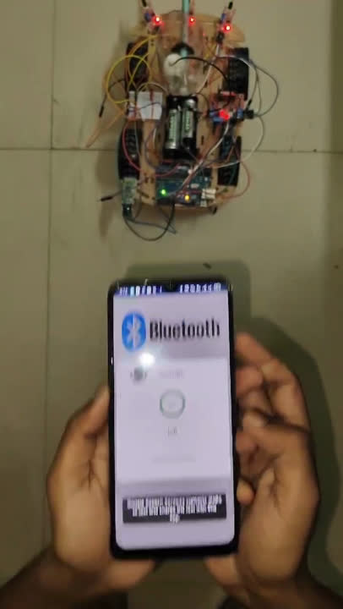
LEFT INSTRUCTION
Whenever the speech recognizer detects the Left speech, then the car moves as shown
LEFT

Slide 19
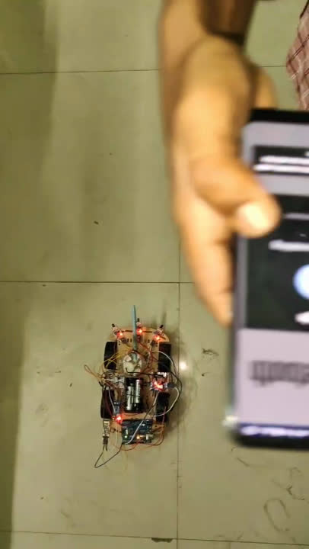
FORWARD INSTRUCTION
Whenever the speech recognizer detects the Forward speech, then the car moves as shown
FORWARD

Slide 20
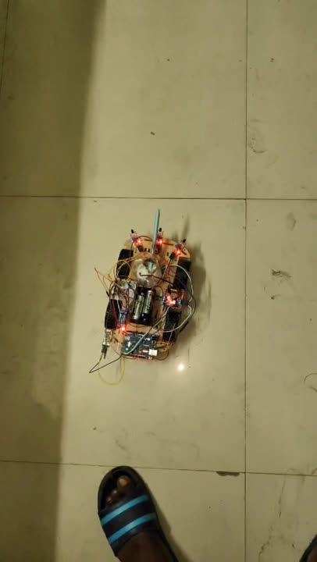
BACKWARD INSTRUCTION
Whenever the speech recognizer detects the Back speech, then the car moves as shown
BACK

Slide 21
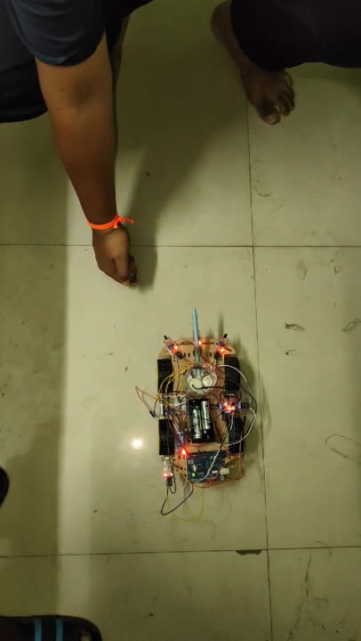
FIRE DETECTION DEMONSTRATION
There are three flame sensors on the car, responsible for detecting fire up to a certain distance.
If the flame is placed left concerning the truck, it moves towards the left and detects the flame.
LEFT_F

Slide 22
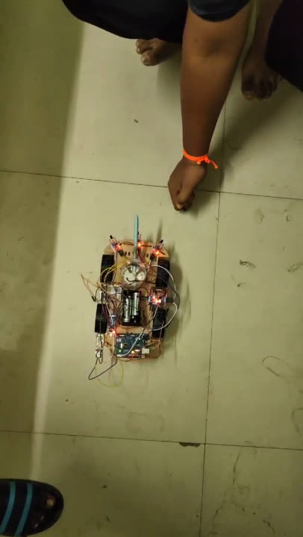
If the flame is placed right with respect to truck then it moves towards right and detects the flame.
RIGHT_F

Slide 23
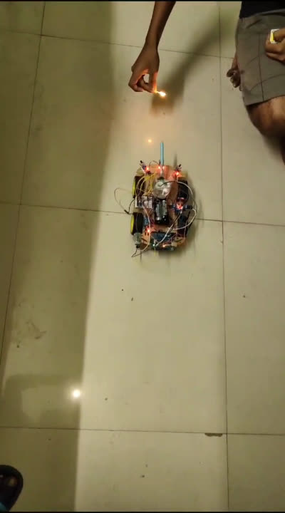
If the flame is placed front with respect to truck then it moves towards front and detects the flame.
FRONT_F

Slide 24
After the sensor detects fire, the car moves towards the fire and stops at certain distance from the fire , spills water on it as shown in video.
FIRE_PUMP

Slide 25

THANK YOU

